Slide 1
SEE Link Connecting Markets
Iliyan Dimitrov
Corporate Development, BSE-Sofia
Skopje, March 29, 2016

Slide 2
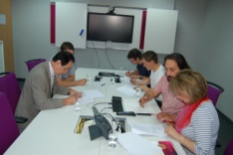
Historical Milestones
Introduction | Benefits | Concept | Market Data | FEA | Indices | Upcoming
Signing the grant agreement between EBRD and SEE Link for financing the SEE Link Project
System
go-live!
System for order routing Development
Tender for selection of developer of the project
March
2016
Dec - Mar
2016
Apr. – Dec.
2015
April 2015
Febr. – Apr.
2015
July – Dec. 2014
System testing by the participating exchanges’ members & launching SEE Link’s web-site
July
2014
Selecting Evolve DD, Ljubljana и NeoCom AD, Skopje for Project Developer
April 2014
Selection of project manager and development of ToR
Establishment of SEE LINK d.o.o.

Slide 3
For the Exchanges
Introduction | Benefits | Concept | Market Data | FEA | Indices | Upcoming
Visibility
Expandability
Accessibility
Affordability
Evolvability

Slide 4
Participants
Introduction | Benefits | Concept | Market Data | FEA | Indices | Upcoming
www.see-link.net
Orders
Originating Broker - ErBr
(sending orders
&
receiving trades)
Executing
Broker - ExBr
(receiving orders
&
sending trades)
FIX API
FEA
FIX API
FEA
Trade
reports
Participating Exchange
Market data, reference data, news, market messages

Slide 5
How to become a member
http://www.see-link.net/publications/36
Introduction | Benefits | Concept | Market Data | FEA | Indices | Upcoming
OrBr Agreement
OrBr Agreement
Membership Application
Membership Application
Broker “ABC”
ExBr Agreement
ExBr Agreement
Broker “XYZ”
Inter-Broker
Agreement

Slide 6
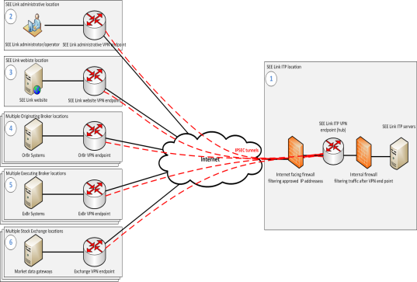
How to connect
Introduction | Benefits | Concept | Market Data | FEA | Indices | Upcoming
FIX API
Front-End Application

Slide 7
Participants
Introduction | Benefits | Concept | Market Data | FEA | Indices | Upcoming
OrBr
OrBr
OrBr
OrBr
OrBr
OrBr
OrBr
Transferred by the participating exchanges to SEE Link
SEE Link – Exchange connection through FiX
SEE Link distributes the data only to appropriate Originating Brokers
LJSE
ZSE
BSE
MSE
BELEX

Slide 8
Securities, order types, validity
Introduction | Benefits | Concept | Market Data | FEA | Indices | Upcoming
Securities
Shares
Rights
Orders
Market
Limit
Validity
Daily
Good-till-date
Treasuries
Iceberg
Good-till-canceled
Preferred shares

Slide 9
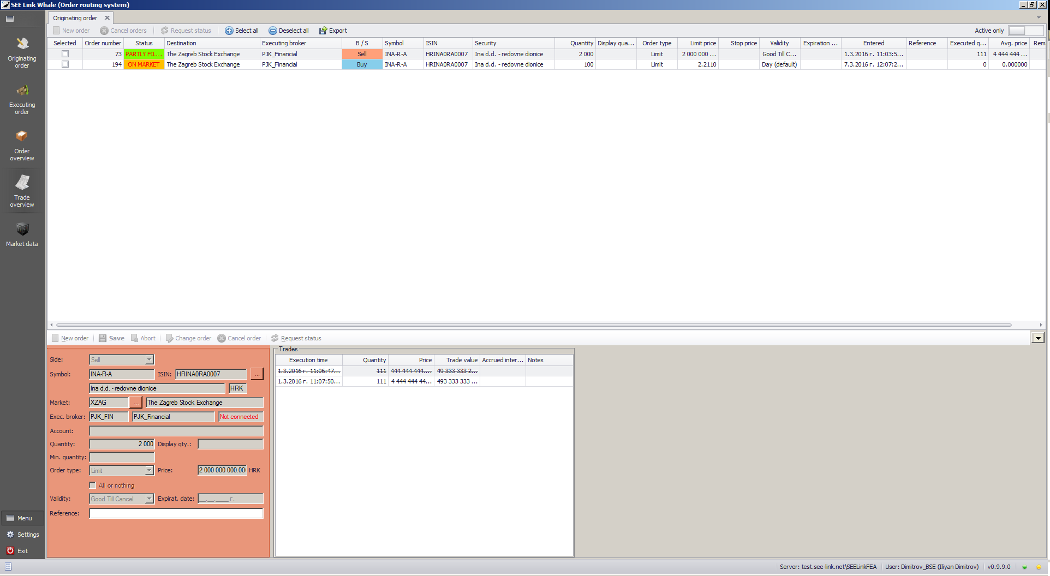
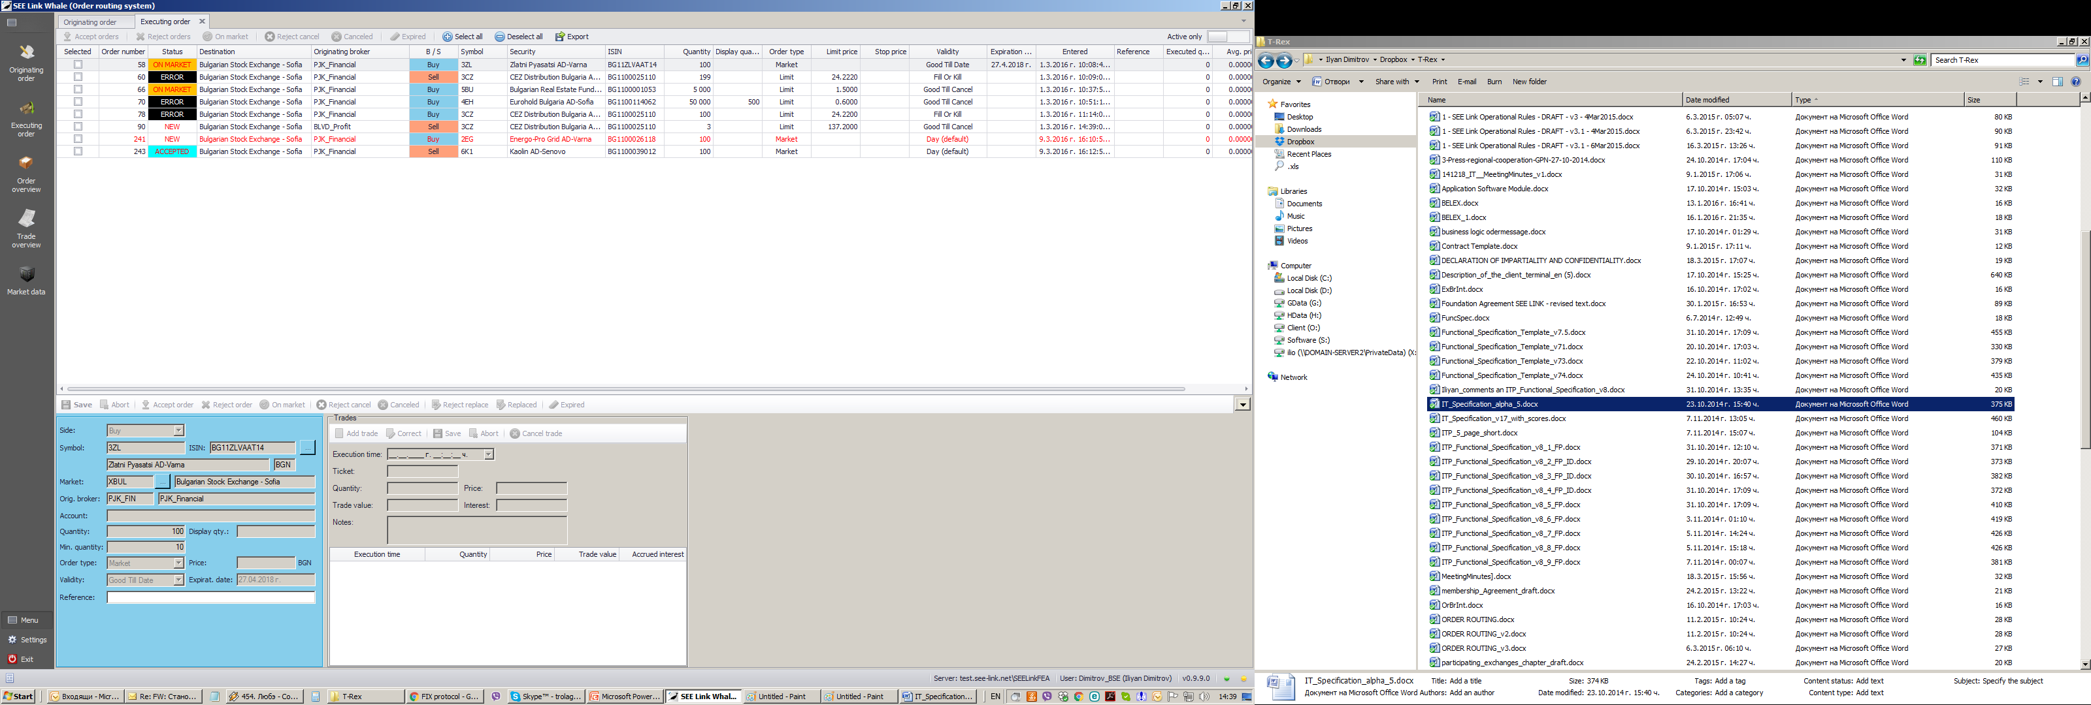
Front-end application
Introduction | Benefits | Concept | Market Data | FEA | Indices | Upcoming

Slide 10
Front-end application
Introduction | Benefits | Concept | Market Data | FEA | Indices | Upcoming

Slide 11
Front-end application
Introduction | Benefits | Concept | Market Data | FEA | Indices | Upcoming

Slide 12
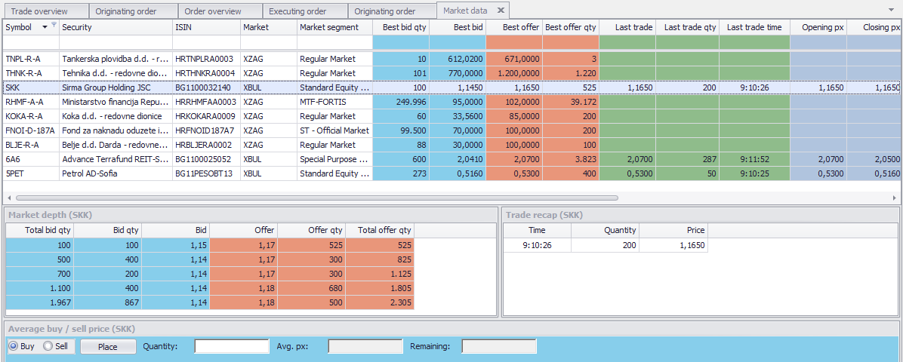
Market Data
Introduction | Benefits | Concept | Market Data | FEA | Indices | Upcoming

Slide 13
Trade Overview
Introduction | Benefits | Concept | Market Data | FEA | Indices | Upcoming
Characteristics | Index 1 | Index 1
Type | Free-float Market Cap | Equally weighted
Structure | 5 / 3 / 2 | 5 / 3 / 2
Currency | EUR | EUR
Calculation | Daily (1 minute) | Daily (1 minute)
Price used | Last Price | Last Price
Starting value | 100 | 100
Rebalancing | March & September | March & September
Free float adjustment | March, June, September, December | March, June, September, December

Slide 14
Trade Overview
Thank you!

